Slide 1
Active Directory-AKA
Active Directory Domain Services
Part 2
Dr John O’Donoghue

Slide 2

Global Catalog
The global catalog is a distributed data repository that contains a searchable, partial representation of every object in every domain in a multidomain Active Directory Domain Services (AD DS) forest.
The global catalog is stored on domain controllers that have been designated as global catalog servers and is distributed through multimaster replication.
Searches that are directed to the global catalog are faster because they do not involve referrals to different domain controllers.
Subset of the Attributes of All Objects
Domain
Domain
Domain
Domain
Domain
Domain
Global Catalog
Global Catalog Server
Queries
Group membership
when user logs on

Slide 3
Global Catalog—Details
Every domain controller stores the objects for the domain in which it is installed.
However, a domain controller designated as a global catalog server stores the objects from all domains in the forest.
For each object that is not in the domain for which the global catalog server is authoritative as a domain controller, a limited set of attributes is stored in a partial replica of the domain.
Therefore, a global catalog server stores its own full, writable domain replica (all objects and all attributes) plus a partial, read-only replica of every other domain in the forest.
The global catalog is built and updated automatically by the AD DS replication system.
The object attributes that are replicated to global catalog servers are the attributes that are most likely to be used to search for the object in AD DS.
The attributes that are replicated to the global catalog are identified in the schema as the partial attribute set (PAS) and are defined by default by Microsoft. However, to optimize searching, you can edit the schema by adding or removing attributes that are stored in the global catalog.

Slide 4








Global Catalog
Subset of the Attributes of All Objects
Domain
Domain
Domain
Domain
Domain
Domain
Global Catalog
Global Catalog Server
Queries
Group membership
when user logs on

Slide 5
Introduction to the Role of DNS in Active Directory
Name Resolution
  DNS translates computer names to IP addresses
  Computers use DNS to locate each other on the network
Naming Convention for Windows 2000 Domains
  Windows uses DNS naming standards for domain names
  DNS domains and Active Directory domains share a common hierarchical naming structure
Locating the Physical Components of Active Directory
  DNS identifies domain controllers by the services they provide
  Computers use DNS to locate domain controllers and global catalog servers

Slide 6






DNS Host Names and Windows Computer Names
DNS host record and Active Directory object represent the same physical computer
DNS allows computers to locate domain controllers within Active Directory
“.”
com.
microsoft
Active Directory
sales
training
training.microsoft.com
Builtin
computer1
Computers
Computer1
Computer2
FQDN = computer1.training.microsoft.com
Windows Computer Name = Computer1

Slide 7

DNS Requirements for Active Directory
DNS Requirements to Support Active Directory
Support for SRV records (mandatory)
Support for the dynamic update protocol (recommended)
Support for incremental zone transfers (recommended)

Slide 8




Characteristics of Multiple Domains
Reduce Replication Traffic
Maintain Separate and Distinct
Security Policies Between Domains
Preserve the Domain Structure of
Earlier Versions of Windows NT
Separate Administrative Control

Slide 9
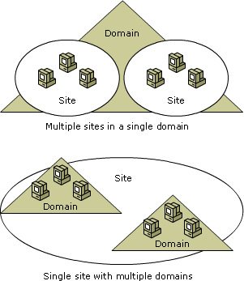
Active Directory Physical Structure
Domain Controllers
  A domain controller is a server that is running a version of the Windows Server® operating system and has Active Directory® Domain Services installed.
Sites
  Active Directory uses topology information, stored as site and site link objects in the directory, to build the most efficient replication topology. You use Active Directory Sites and Services to define sites and site links. A site is a set of well-connected subnets.

Slide 10


Domain Controllers
Domain Controllers:
  Participate in Active Directory replication
  Perform single master operations roles in a domain
Domain
User1
User2
Replication
User1
User2
Domain Controller
Domain Controller
= A Writeable Copy of the Active Directory Database

Slide 11
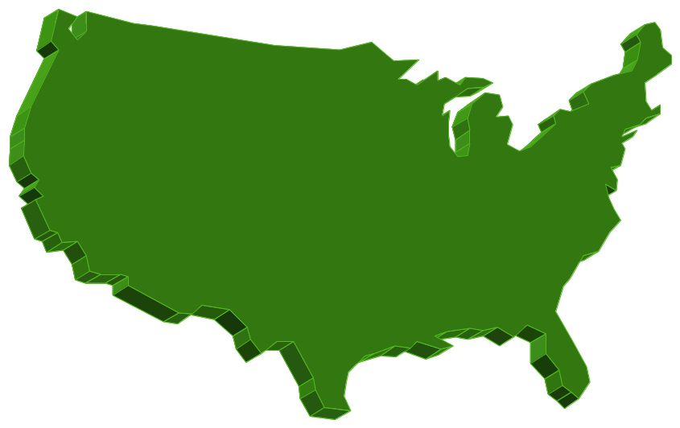

Sites
Seattle
New York
Chicago
Los Angeles
Site
IP subnet
IP subnet
Sites:
  Optimize replication traffic
  Enable users to log on to a domain controller by using a reliable, high-speed connection

Slide 12
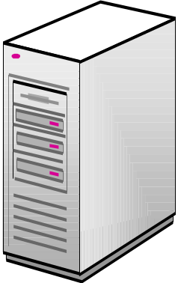
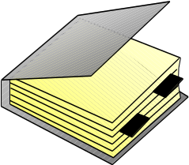
Introduction to Active Directory Replication
Multimaster Replication with a Loose Convergence
Domain
Controller B
Replication
Domain
Controller A
Domain
Controller C

Slide 13
Replication Components and Processes
How Replication Works
  Active Directory uses a multimaster model which means changes can be made on any controller and the changes are sent to all other controllers. The replication path in Active Directory forms a ring which adds reliability to the replication.
Replication Latency
Resolving Replication Conflicts
Optimizing Replication

Slide 14
How Replication Works
Active Directory Update
Domain
Controller B
Add
Modify
Move
Delete
Replicated Update
Replication
Originating Update
Domain
Controller A
Domain
Controller C
Replicated Update

Slide 15
Replication Latency
Default Replication Latency (Change Notification) = 5 minutes
When No Changes, Scheduled Replication = One Hour
Urgent Replication = Immediate Change
Notification
Replicated Update
Change Notification
Domain
Controller B
Replication
Originating Update
Domain
Controller A
Change Notification
Replicated Update
Domain Controller C

Slide 16
Resolving Replication Conflicts
Domain Controller A
Domain Controller B
Stamp
Stamp
Originating Update
Originating Update
Conflict
Conflict
Stamp
Version Number
Timestamp
Server GUID
Conflicts Can Be Due to:
Attribute Value
Adding/Moving Under a Deleted Container Object or the Deletion of a Container Object
Sibling Name

Slide 17
Optimizing Replication
Domain
Controller B
GUID
USN
GUID
USN
Up-To-Dateness
Vector
Update
Replicated Update
Originating Update
Domain
Controller A
Update
GUID
USN
Domain
Controller C
Replicated Update

Slide 18
Replication Topology
Directory Partitions
What Is Replication Topology?
Global Catalog and Replication of Partitions

Slide 19
Directory Partitions
Directory Partitions
Schema
Forest
Contains definitions and rules for creating and manipulating all objects and attributes
Configuration
Contains information about Active Directory structure
contoso.msft
Holds information about all domain-specific objects created in Active Directory
Domain
Active Directory Database
  A directory partition is where the AD information is segregated and logically stored.
  There are three native partitions Schema/Configuration/Domain and additionally there is also the Application partition.

Slide 20

What Is Replication Topology?
A2
A1
A2
B2
A1
B1
A4
A3
A4
B3
A3
Domain Controllers
from Different Domains
Domain Controllers
from the Same Domains
Domain A Topology
Domain B Topology
Schema/Configuration Topology
Domain A Topology
Schema/Configuration Topology
The AD DS uses a multi-master replication topology that allows you to use any domain controller to manipulate the domain database and to replicate changes to its replication partners.

Slide 21

What Is Replication Topology?
A2
A1
A2
A1
B2
B1
A4
A3
A4
A3
B3
Domain Controllers
from Different Domains
Domain Controllers
from the Same Domains
Domain A Topology
Schema/Configuration Topology
Domain A Topology
Domain B Topology
Schema/Configuration Topology

Slide 22

Global Catalog and Replication of Partitions
Partial Directory Partition Replica
Schema
Configuration
contoso.msft
Holds read only copy of all domain directory partitions
namerica.contoso.msft
Global Catalog Server

Slide 23
Global Catalog and Replication of Partitions
A1
A2
B2
B1
A3
A4
B3
Domain A Topology
Domain B Topology
Schema/Configuration Topology

Slide 24
Automatic Replication Topology Generation
KCC
KCC
KCC
KCC
KCC
KCC
A2
A1
A2
A1
A3
A3
Automatic Replication
Topology Generation
KCC
KCC
KCC
KCC
A4
A8
A4
A8
A6
A7
A6
A7
A5
A5
KCC
KCC
KCC
KCC
KCC
KCC
Domain Topology
Schema/Configuration Topology

Slide 25
Methods for Administering a Windows Network
Using Active Directory for Centralized Management
Managing the User Environment
Delegating Administrative Control

Slide 26








Using Active Directory for Centralized Management
Domain
Domain
Search
OU1
Computers
OU1
OU2
Computer1
Users
User1
OU2
User1
Computer1
User2
Printer1
Users
User2
Printers
Printer1
Active Directory:
  Enables a single administrator to centrally manage resources
  Allows administrators to easily locate information
  Allows administrators to group objects into OUs
  Uses Group Policy to specify policy-based settings

Slide 27
Group Policy
A Group Policy object linked to a site (using Active Directory Sites and Services) applies to all domains at the site.
A Group Policy object applied to a domain applies directly to all users and computers in the domain and by inheritance to all users and computers in organizational units (and in generic Active Directory containers) farther down the Active Directory tree as seen in the Active Directory Users and Computers namespace.
A Group Policy object applied to an organizational unit applies directly to all users and computers in the organizational unit and by inheritance to all users and computers in organizational units (and in generic Active Directory containers) farther down the Active Directory tree as seen in the Active Directory Users and Computers namespace.
Group Policy Objects are actually composed of two parts, the Group Policy Container (GPC) which exists in Active Directory and the Group Policy Template (GPT) where the actual content of your GPOs resides.

Slide 28





Managing the User Environment
Domain
1
2
3
OU1
OU2
OU3
1
2
3
Apply Group Policy Once
Windows Server Enforces Continually
Use Group Policy to:
  Control and lock down what users can do
  Centrally manage software installation, repairs, updates,
  and removal
  Configure user data to follow users whether they are online or offline

Slide 29







Delegating Administrative Control
Domain
OU1
Admin1
OU2
Assign Permissions:
  For specific OUs to other
  administrators
  To modify specific attributes of
  an object in a single OU
  To perform the same task in all OUs
Customize Administrative Tools to:
  Map to delegated administrative tasks
  Simplify interface design
Admin2
OU3
Admin3

Slide 30
Review
Introduction to Active Directory
Active Directory Logical Structure
Role of DNS in Active Directory
Active Directory Physical Structure
Methods for Administering a Windows Network using AD

Slide 31


